Slide 1

AI @ DATIS and PTA
A story of establishing AI
@Inflectra | #InflectraCon

Slide 2
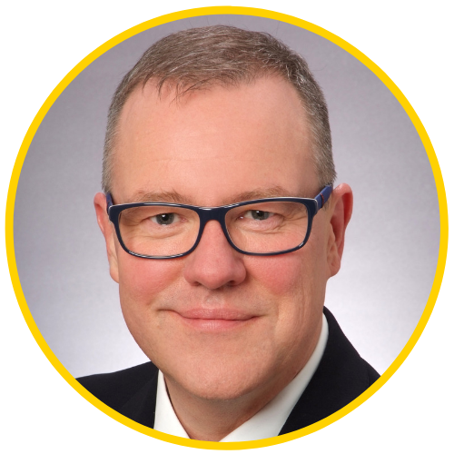
Dennis Hassloecher
Managing Director, DATIS
Member of the Board, PTA

Slide 3
History of AI
1st wave 40s/50s – stochastic gradient descent – operator driven and even learning von data ➔ scoring systems
2nd wave 80/90s – connectionism/parallel distributed processing – neuron with simple features combined in a network
3rd wave started 2006 – deep learning – new unsupervised learning techniques – deep models even from smaller datasets

Slide 4
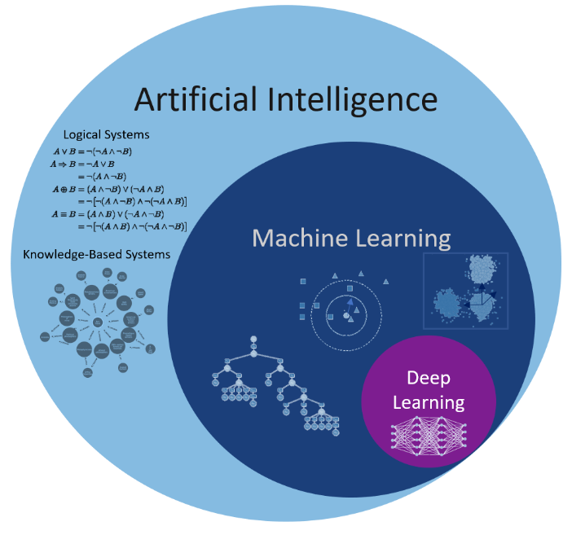
AI technologies at a glance

Slide 5
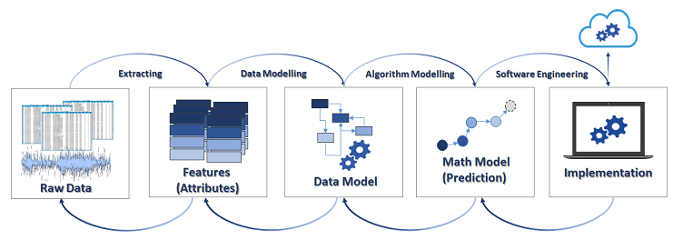
AI - how does come alive

Slide 6
Where is AI today
Incredible hardware improvements
Machine learning with hundreds of algorithms
Lack of mathematics to choose the right approach
Use cases everywhere

Slide 7
DATIS/PTA way to AI
Partnership with Kendaxa – Creating Use Case based on the AI framework – they do it fast and with high accuracy.
Leveraging the PTA knowledge of business processes/ applications, system integration and BI.
Establishing a Docker platform at DATIS with high end CPU/GPU power and storage systems.

Slide 8
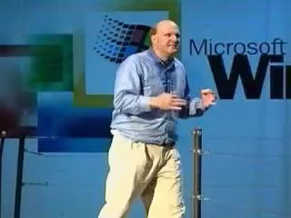
DATIS/PTA way to AI
Following
Steve Ballmer…

Slide 9
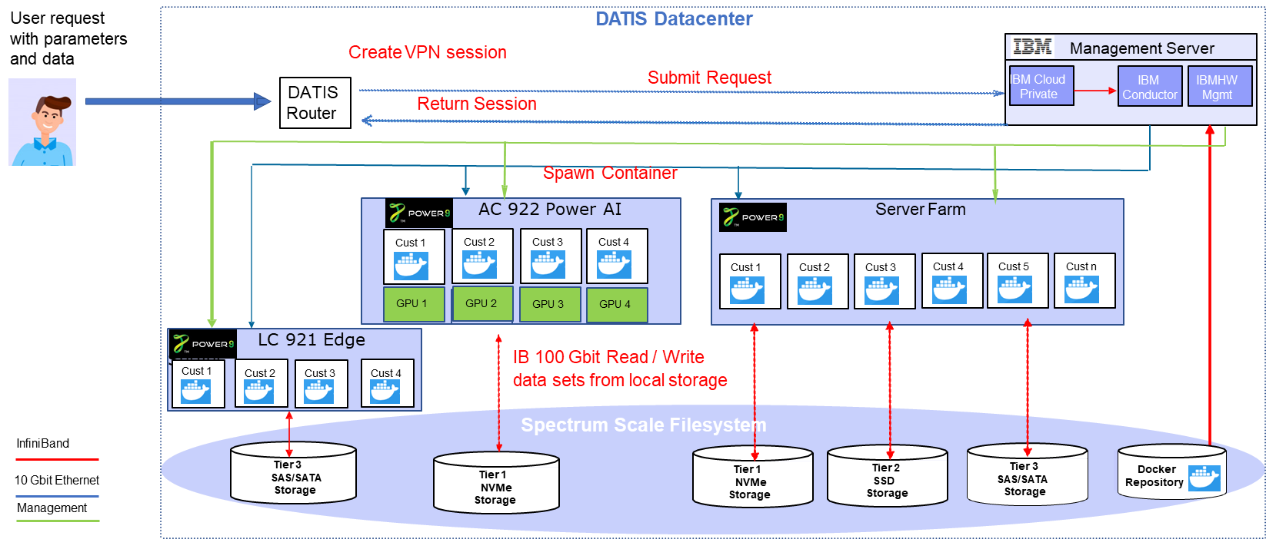
DATIS/PTA way to AI
Our focus on developers with this platform.

Slide 10
Where is AI going
Intuitive AI not before 2050
New – no Turing – computing
Light could be a break through

